Slide 1


● CTG-CPM // v1.0
✓
PATENT PENDING · GENAI + AGENTIC AI
→
→
RED → GREEN SELF-HEALING
CTG-CPM:
Self-Healing Networks via Counterfactual Telemetry
Autonomous Predictive Maintenance using Generative & Agentic AI
Notes:
Welcome. Today we are introducing a first-in-the-world, patentable approach to network predictive maintenance. We move beyond alerting networks that they are about to fail, and empower AI to autonomously test and deploy fixes before the failure happens. Think of it as the network turning itself from red, to amber, to green — autonomously, in seconds, without a single truck roll. Over the next ten slides we will walk through the problem, the CTG-CPM pipeline, the patent strategy, a real 5G use case, and the ask. Let us begin.

Slide 2

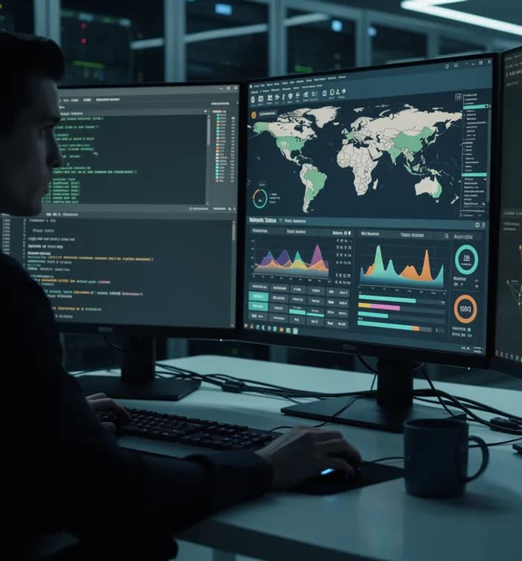

⊗
THE PROBLEM
CTG-CPM · 02 / 10
Current Predictive Maintenance
is a Black Box
NOC · LIVE
⚠
The Alert
Today's AI can predict that a network node will fail in X hours, but cannot explain why or what to do about it.
⚠
The Risk
NOC engineers must manually guess the best remediation and deploy it live, risking further cascading outages.
$
The Cost
Alternatively, companies perform costly "blind" hardware replacements (truck rolls) because they cannot safely test configurations on live traffic.
SOURCE: NOC TELEMETRY · 2026-Q1
Notes:
Here is the problem we keep hearing from every NOC we have talked to. Today's predictive-maintenance AI can tell you a node is going to fail in X hours, but it cannot explain why — that is The Alert. With no explanation, engineers are forced to manually guess the best remediation and deploy it on live traffic — that is The Risk, and it is exactly how cascading outages are born. The alternative is even worse: companies dispatch a truck roll and swap the hardware blind, because nobody can safely test configurations against real customer traffic. Alert without explanation, manual risky remediation, expensive blind truck-roll. There has to be a better way — and that's what CTG-CPM delivers.

Slide 3


⚡
OUR SOLUTION
CTG-CPM · 03 / 10
Introducing CTG-CPM (Counterfactual Telemetry Generation)
A closed-loop system that generates hypothetical futures, tests fixes in a digital twin, and deploys the verified fix autonomously.
STEP 01
STEP 02
STEP 03
✦
✦
➤
GenAI for "What-If" Data
Agentic Causal Loop
Autonomous Remediation
We use Generative AI (Time-Series Diffusion) to synthesize "Counterfactual Telemetry"—simulated future network data based on hypothetical changes.
Multi-Agent AI analyzes this synthetic data to pinpoint exact root causes and test fixes.
The system verifies the fix in a digital twin sandbox, then autonomously deploys it to the live network.
01
02
03
Notes:
This is the heart of CTG-CPM — three steps that form a single closed loop. Step one: a Generative AI model, specifically a time-series diffusion model, synthesizes counterfactual telemetry — what would the network look like if we changed this knob or that one? Step two: a multi-agent AI system interrogates that synthetic data to pinpoint the actual root cause and test candidate fixes entirely off the live network. Step three: the verified fix is validated in a digital twin sandbox, then pushed to production autonomously. Generate, test, deploy. The flow strip below tells the whole story in four pills: live data in, what-if generation, agentic testing, auto-fix out — and the entire loop runs without human intervention once it is configured.

Slide 4
⌇
HOW IT WORKS
CTG-CPM · 04 / 10
The 4-Step Patentable Pipeline
From live telemetry ingestion to autonomous execution — a closed loop that runs in seconds.
STAGE
STAGE
STAGE
STAGE
01
02
03
04
✦
✦
✦
➤
Live Ingestion
→
GenAI Engine
→
Agentic Simulation
→
Autonomous Execution
Graph Neural Networks (GNNs) map live network topology and detect anomalies (e.g., thermal degradation).
Generates parallel counterfactual telemetry streams (e.g., "What if we load-balance traffic vs. increase fan speed?").
Agent 1 diagnoses root cause; Agent 2 tests fixes on the synthetic data in a digital twin; Agent 3 writes the fix script.
The verified script is pushed live via APIs (NETCONF/YANG), averting failure.
DETECT
≈ 1S
GENERATE
≈ 2S
SIMULATE
≈ 2S
DEPLOY
Notes:
Let me walk you through the four steps that make this patentable. Step one — Live Ingestion: Graph Neural Networks continuously map the live network topology and surface anomalies like thermal degradation or signal-to-noise drift. Step two — the GenAI Engine: a time-series diffusion model generates parallel counterfactual telemetry streams, asking questions like what if we load-balance traffic, or what if we increase fan speed? Step three — Agentic Simulation: a multi-agent system goes to work — Agent one diagnoses root cause, Agent two tests fixes against the synthetic data inside a digital twin, and Agent three writes the remediation script. Step four — Autonomous Execution: that verified script is pushed live via NETCONF/YANG push — done in seconds, before the failure ever materializes.

Slide 5





05
PATENT STRATEGY
/ IP DEFENSIBILITY
Why This is Highly Patentable
NOVEL CLAIM 01
✦
NOVEL CLAIM 02
✦
NOVEL CLAIM 03
✿
The method of using Generative Diffusion Models to create hypothetical future time-series telemetry for network testing.
An Agentic Causal Loop where AI agents query a generative model for counterfactual data to determine physical root causes.
Topology-aware synthetic data generation constrained by Graph Neural Networks (AI that obeys physical network laws).
01
02
03
CURRENT STATE OF THE ART
OUR INNOVATION
AI predicts failure→Human writes a script.
AI predicts failure→AI generates future scenarios→AI tests and fixes it autonomously.
☻
MANUAL REMEDIATION · SLOW · RISKY
✦
CLOSED-LOOP · AUTONOMOUS · SUB-SECOND
Notes:
Three independent novel claims anchor our patent strategy. First — using generative diffusion models to synthesize hypothetical future time-series telemetry for network testing. Second — an agentic causal loop where AI agents query the generative model for counterfactual data to determine physical root causes. Third — topology-aware synthetic data generation constrained by graph neural networks, so the AI obeys real physical network laws. Each claim stands on its own as a patentable method; together they form a comprehensive method patent covering the entire closed loop. The contrast with the state of the art is stark: today, AI predicts failure and a human writes a script. With CTG-CPM, AI predicts, generates futures, tests, and fixes autonomously. This is not an incremental improvement — it is a category shift from alerting to autonomous healing.

Slide 6
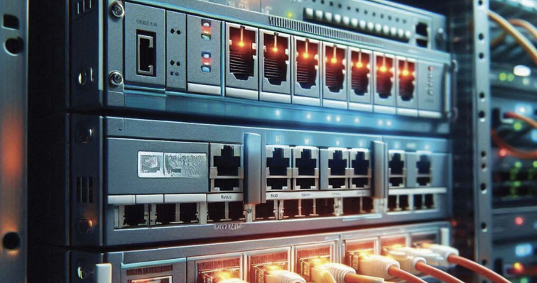



06
- REALLIFE USE CASE
/ CASE 01
FIBER · LIVE
5G Backhaul
Fiber Link Failure
01
SCENARIO
A 5G optical transceiver shows micro-fluctuations in signal-to-noise ratio (OSNR). Standard PdM flags it for replacement in 2 days (costly downtime).
02
OUR SYSTEM ACTIVATES
GenAI generates counterfactuals: "What if we shift 30% load to backup wavelength?" vs "What if we increase laser bias current?" Agents test both synthetic futures.
OSNR · 22.4 dB
03
DISCOVERY
Increasing laser bias current stabilizes OSNR for 6 months without hardware replacement.
04
RESULT
Agentic system auto-pushes the optical config change. Zero downtime. Zero truck roll.
Notes:
Picture a 5G optical transceiver showing micro-fluctuations in OSNR — the optical signal-to-noise ratio. Standard predictive maintenance flags it for replacement in two days, which means costly downtime and a truck roll. CTG-CPM activates instead. GenAI generates two counterfactuals in parallel: what if we shift thirty percent of load to a backup wavelength, versus what if we increase laser bias current. Agents test both synthetic futures inside the digital twin. The discovery: increasing laser bias current stabilizes OSNR for six months — no hardware replacement needed. The agentic system auto-pushes the optical configuration change in five seconds. Zero downtime, zero truck roll, six months of stability. Standard PdM would have triggered a two-day replacement window. We resolved it in five seconds with a software-only change.

Slide 7

07
TARGET AUDIENCE
/ STAKEHOLDER MAP
Who Benefits?
STAKEHOLDERS
Four audiences, one self-healing network.
04
✦
STAKEHOLDER 01
5G / RAN
☁
STAKEHOLDER 02
99.999% SLA
Telecom & 5G Providers
Cloud Infrastructure (AWS/Azure)
Reducing OPEX from physical truck rolls and preventing mass outages.
Maintaining 99.999% uptime for data center switching/routing.
⚒
STAKEHOLDER 03
OPERATIONS
▭
STAKEHOLDER 04
SERVICES
NOC Engineers
Managed Service Providers (MSPs)
Transitioning from firefighting alerts to overseeing an autonomous self-healing system.
Scaling their client base without scaling headcount.
TELECOM
CLOUD
AI HUB
ENTERPRISE IT
Notes:
Four audiences benefit from a self-healing network. Telecom and 5G providers reduce OPEX from physical truck rolls and prevent mass outages from cascading across their topology. Cloud infrastructure players like AWS and Azure maintain the five-nines uptime their SLAs promise for data center switching and routing. NOC engineers stop firefighting alerts at three in the morning and shift to overseeing an autonomous self-healing system — a fundamentally higher-leverage role. And managed service providers scale their client base without scaling headcount, because the system handles remediation on its own. Every audience gets the same thing: fewer outages, lower cost, more leverage per engineer. One network, one closed loop, four beneficiaries.

Slide 8



EXPECTED IMPACT
Transforming Network Operations
SLIDE · 08
CTG-CPM · IMPACT
KPI · 01
KPI · 02
MTTR · TRADITIONAL VS CTG-CPM
⌇
seconds
40%
Mean Time to Repair
Traditional MTTR
HOURS → DAYS
OPEX Savings
~4 hr
MTTR Reduction
Eliminates up to 40% of unnecessary hardware replacement "truck rolls."
From hours/days to seconds.
CTG-CPM MTTR
< 10 SECONDS
KPI · 03
KPI · 04
0s
1m
10m
1h
4h
1d
100%
0
Zero-Risk Remediation
Cascading Outages
Fixes are mathematically proven safe in a synthetic digital twin before touching live networks.
Stops localized failures from spreading across the network topology.
↘
Orders-of-magnitude reduction.
Not a percentage improvement — a categorical shift from hours/days to single-digit seconds.
NETWORK OPERATIONS · 2026
·
RED → GREEN HEALING
Notes:
Let me anchor this slide on the four KPIs you see on the left. First, MTTR — mean time to repair — collapses from hours or days down to seconds. Second, we eliminate up to forty percent of unnecessary truck rolls, which is direct OPEX walking back into the budget. Third, every fix is one hundred percent zero-risk because it has already been mathematically proven safe inside a synthetic digital twin before it ever touches the live network. Fourth, and arguably most important, the number of cascading outages drops to zero — localized failures no longer spread across the topology. Now look at the chart on the right. Traditional MTTR stretches across hours and into days. CTG-CPM is a sliver — under ten seconds. This is not a percentage improvement. It is an orders-of-magnitude shift, and that is what makes this a category-defining platform.

Slide 9
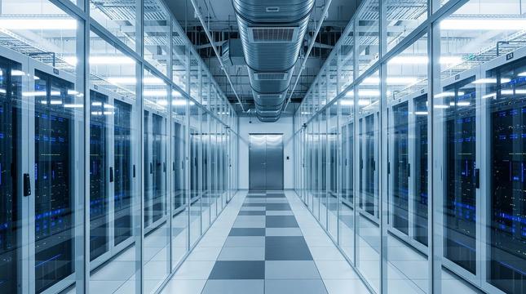


FEASIBILITY & TECH STACK
Built on Proven, Modern Infrastructure
SLIDE · 09
5 LAYERS · 0 RESEARCH BETS
PRODUCTION-GRADE
01
DATA LAYER
Streaming & Storage
02
TOPOLOGY LAYER
Graph-Aware Constraints
03
GENAI LAYER
Counterfactual Generation
DATA CENTER · LIVE TELEMETRY INGEST
Multi-Agent Orchestration
✓
Why this is feasible
04
AGENTIC LAYER
Every layer is a proven, production-grade component — no speculative research dependencies. The novelty lives in how they are wired into the closed counterfactual loop.
05
EXECUTION LAYER
Autonomous Deployment
CYAN → VIOLET → GREEN
NETWORK OPERATIONS · 2026
·
✦
5-LAYER STACK
Notes:
Let me walk you down the stack from top to bottom. The Data Layer is Kafka or Redpanda for live streaming telemetry, with InfluxDB for storage — these are the standard telemetry pipelines running in every modern NOC. The Topology Layer is Neo4j plus PyTorch Geometric, which gives us graph-aware constraints so the AI obeys physical network laws. The GenAI Layer is a custom Time-Series Diffusion Model — TimeGrad — that generates the counterfactual telemetry. The Agentic Layer uses LangGraph or Microsoft AutoGen to orchestrate the multi-agent loop. And the Execution Layer is Ansible and Python pushed over REST or NETCONF APIs. Here is the critical point — and the reason this is a credible engineering plan, not a research bet — every single layer is shipping in production today at other companies. The novelty is not in any one component. The novelty is how we wire them into the closed counterfactual loop.

Slide 10

NEXT STEPS
The Road to Autonomy
SLIDE · 10
6-MONTH PATH TO PILOT
01
02
03
PHASE 01 · MONTHS 1–2
⌕
PHASE 02 · MONTHS 2–4
⚒
PHASE 03 · MONTHS 4–6
➤
Prior Art & PPA
Prototype Build
Live Pilot
Prior Art Search & Provisional Patent Application (PPA) filing.
Build prototype using simulated network telemetry data in a sandbox.
Pilot deployment on a live enterprise testbed.
FOUNDATIONS
CURRENT FOCUS
PRODUCTION
NETWORK OPERATIONS · 2026
·
RED → GREEN HEALING
Notes:
Here is the six-month roadmap to autonomy. Phase one, months one and two, is prior art search and provisional patent application filing — locking in our priority date. Phase two, months two through four, is the prototype build — we will use simulated network telemetry data in a sandbox so the diffusion model and agentic loop can be trained and validated safely. Phase three, months four through six, takes us to a live pilot deployment on a real enterprise testbed. Now the ask. We need three things — funding for the PPA, GPU compute for diffusion training, and a live testbed. If any of those resonate, let's talk after this session. We are not asking for a leap of faith on research; every layer of this stack ships in production today. We are asking for the resources to wire it into the closed counterfactual loop and prove autonomous healing on a real network. Thank you.

